Slide 1
CEREBELLUM
BY
F.O. IGELIGE

Slide 2
INTRODUCTION
The cerebellum is primarily a movement control center, it computes information about intended movements through cerebro-pontocerebellar fibers, and also receives information about the performed movements through spinocerebellar tract, mainly, if movements fail to meet expectations, it sends corrective impulses to the brain to maintain adequate movement and balance.
In contrast to cerebral hemispheres, the right side of the cerebellum is concerned with movements of right side of the body, and the left side of the cerebellum is concerned with movements of left side of the body.

Slide 3
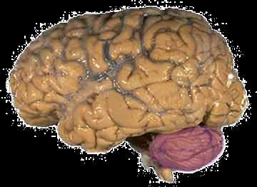
INTRODUCTION
Latin for ‘little brain’
Largest part of hindbrain
• Occupies most of posterior
cranial fossa
• Lies behind pons & medulla
– forming roof of 4th ventricle
• Separated from posterior part of cerebrum
– by tentorium cerebelli

Slide 4
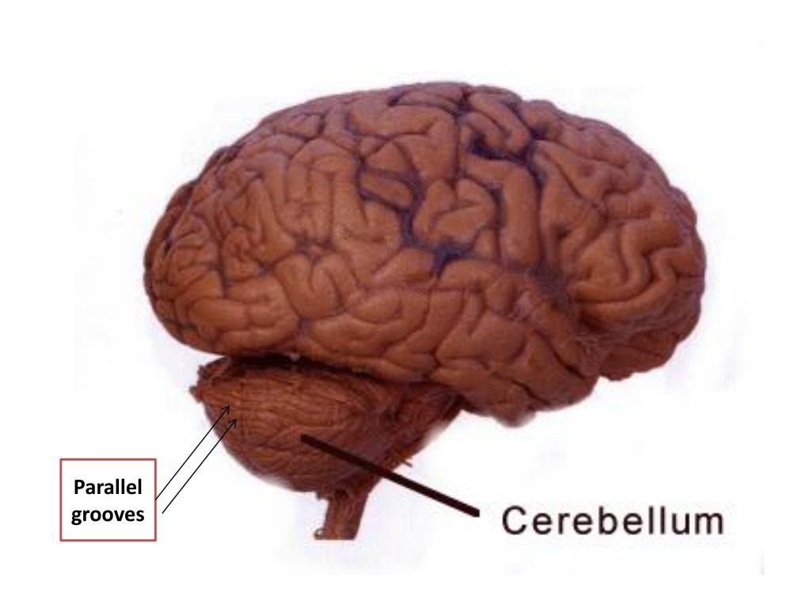

Slide 5
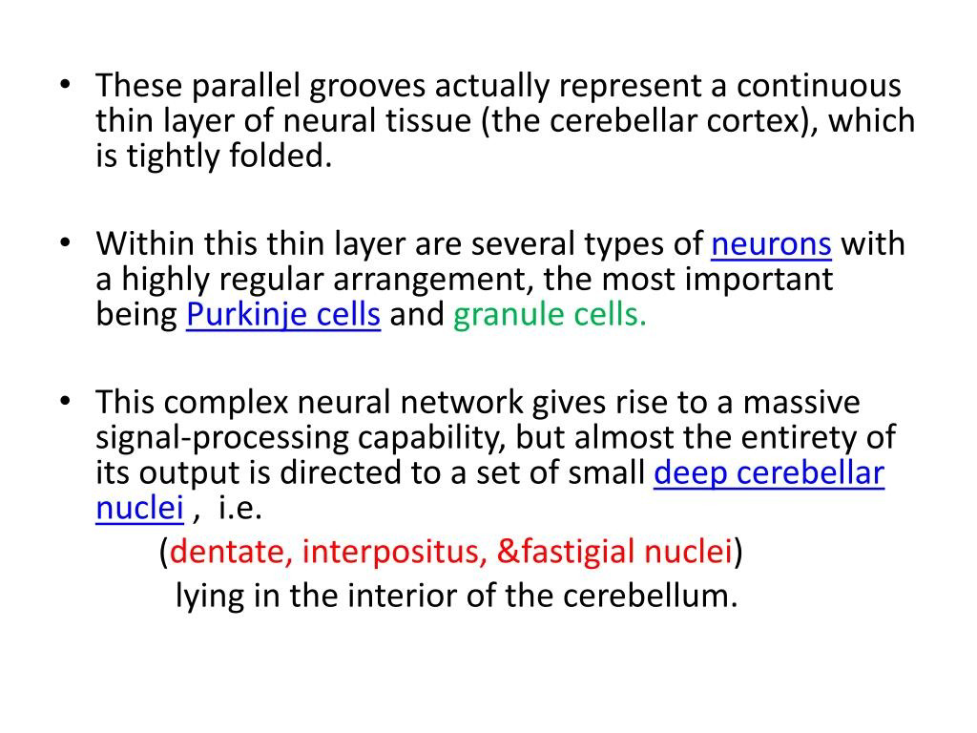

Slide 6
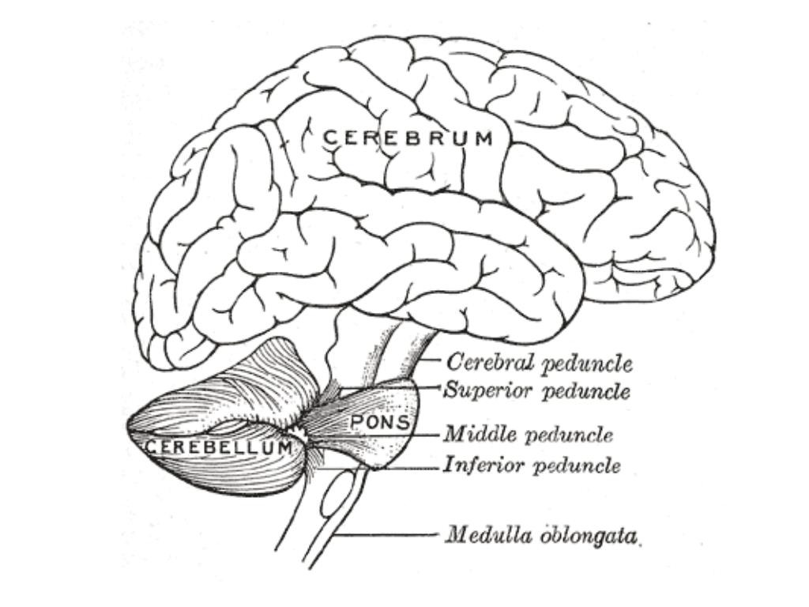

Slide 7
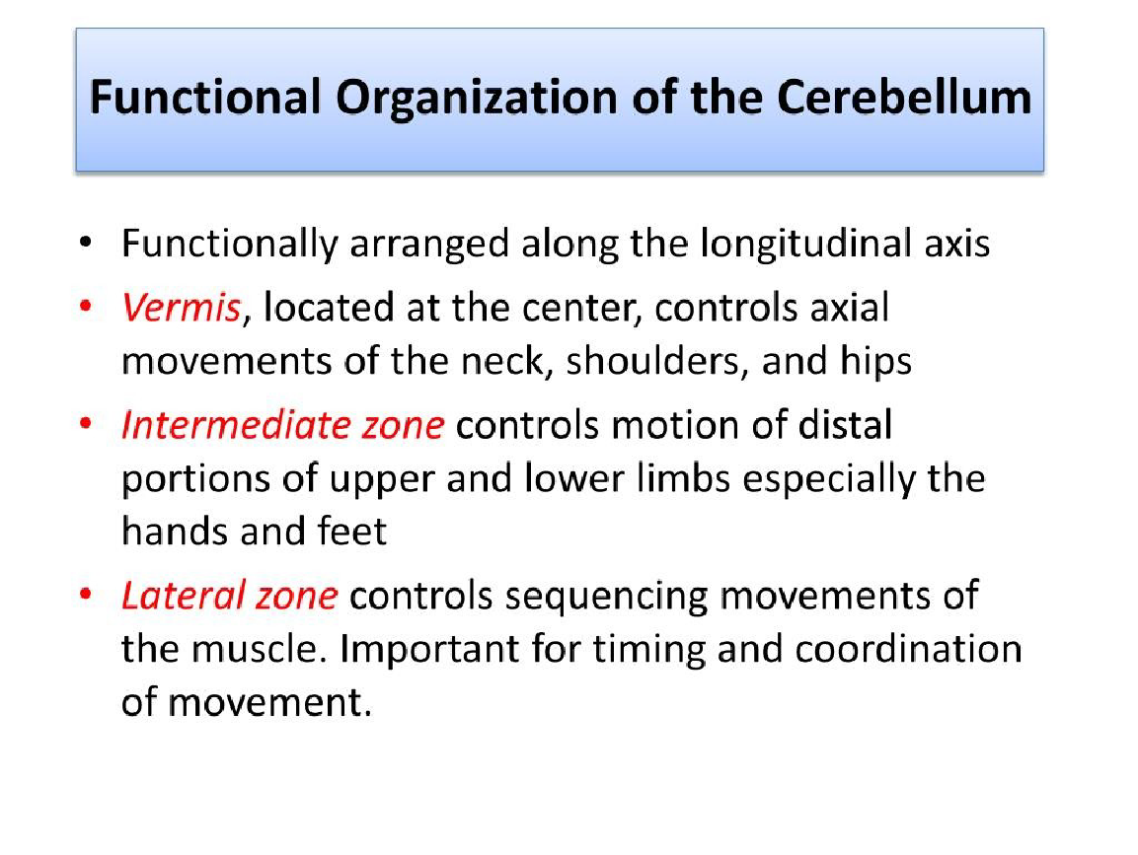

Slide 8
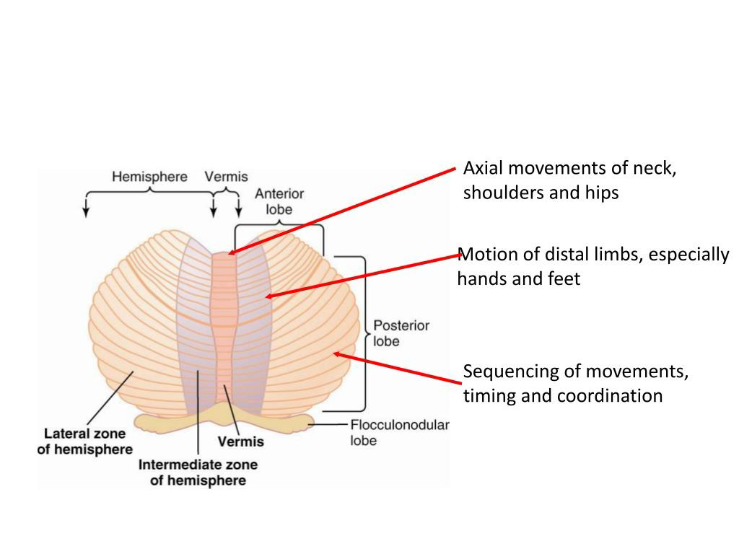

Slide 9
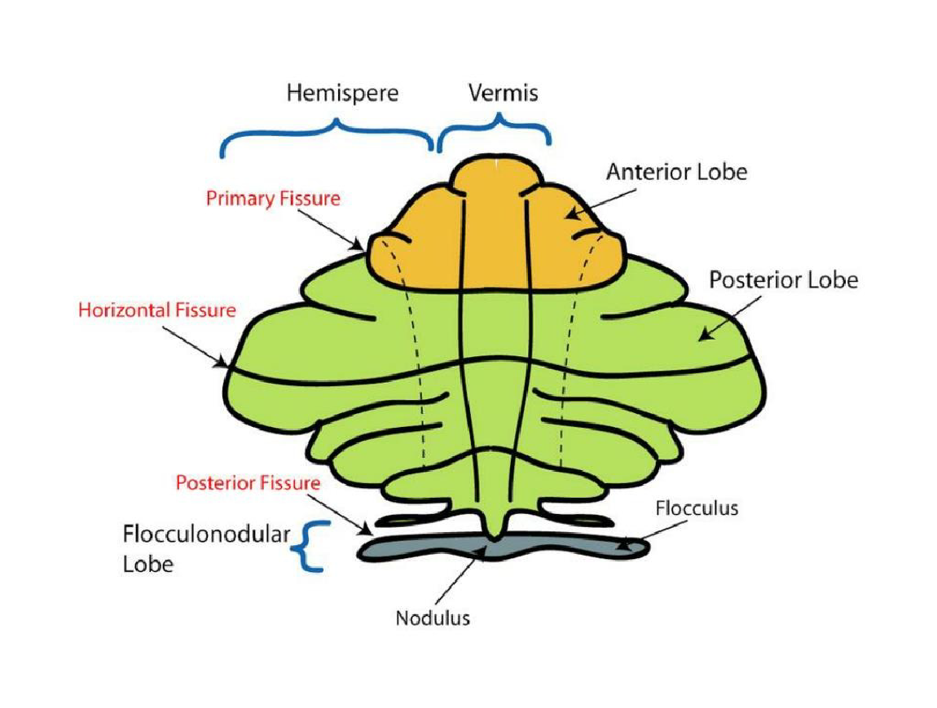

Slide 10
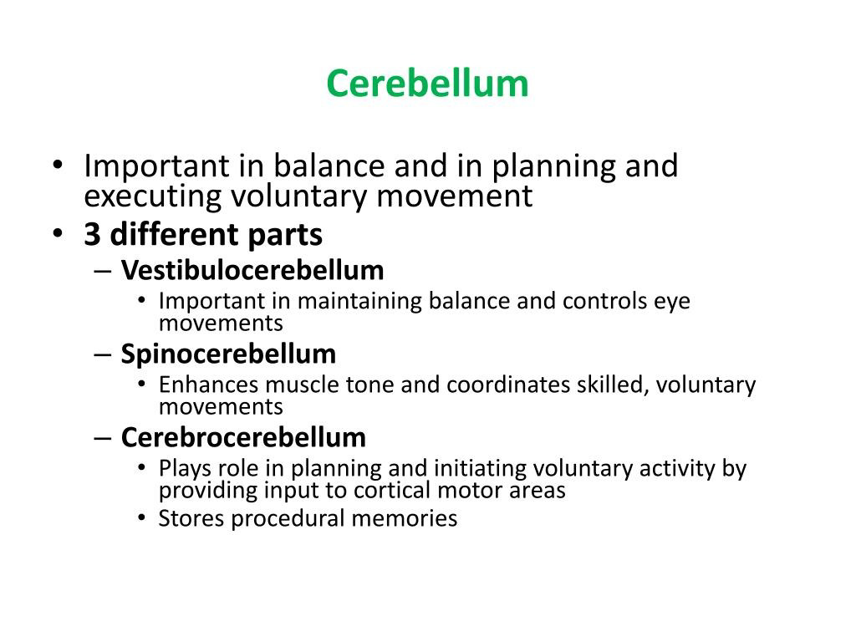

Slide 11
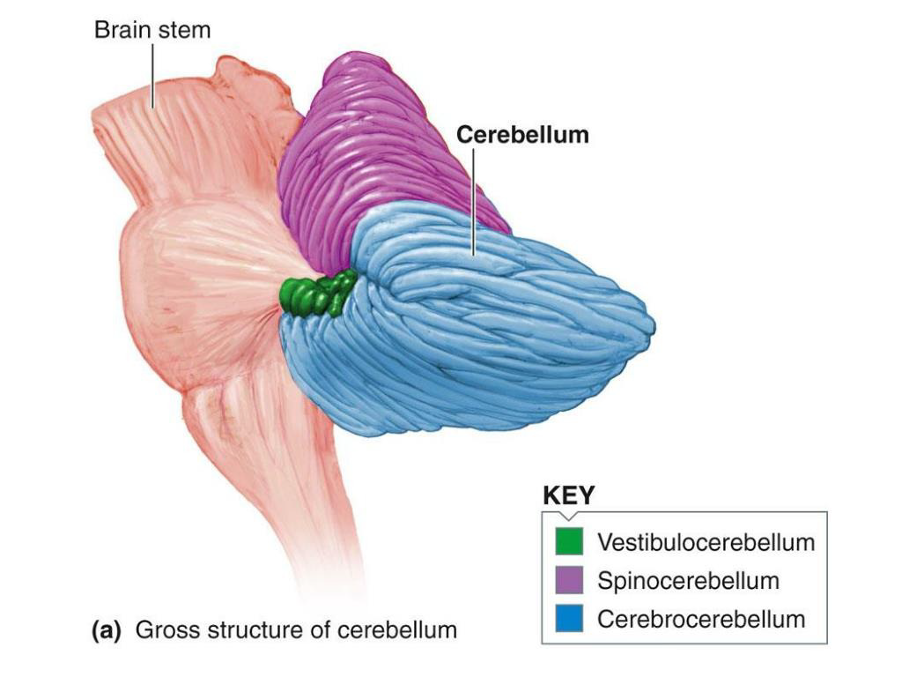

Slide 12
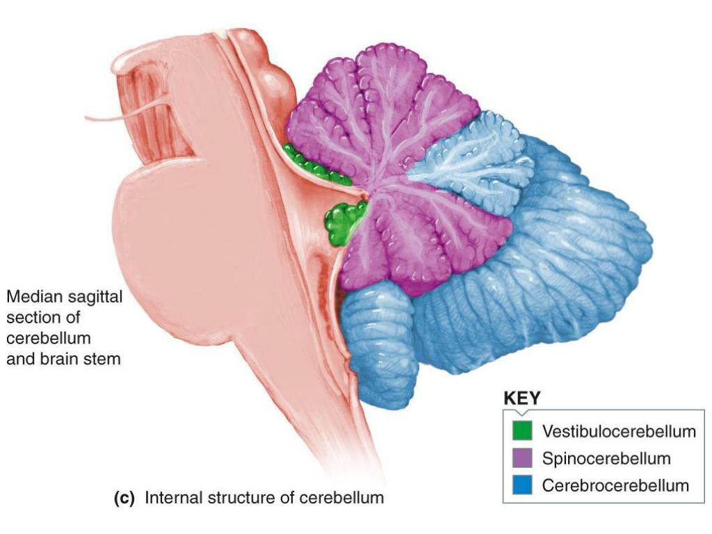

Slide 13
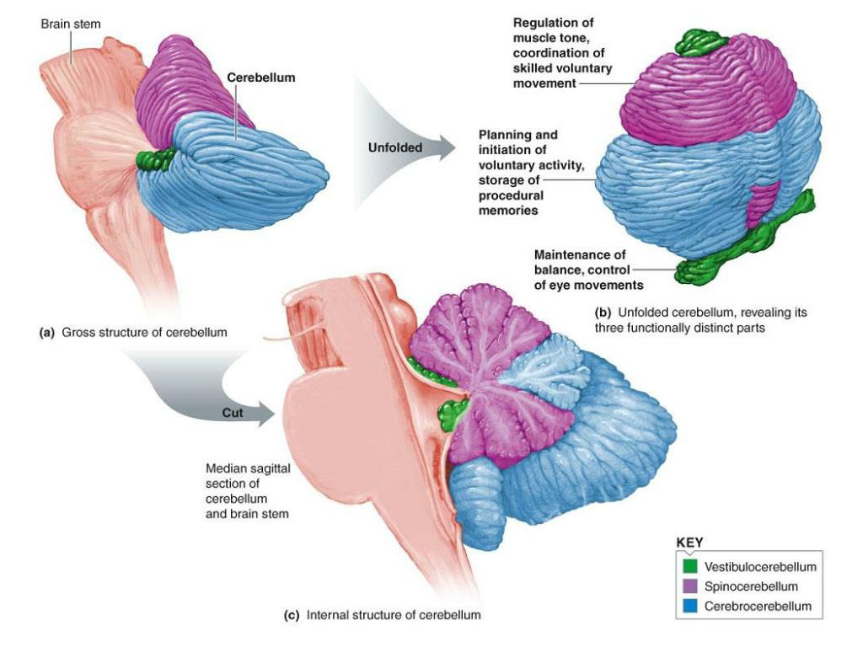

Slide 14
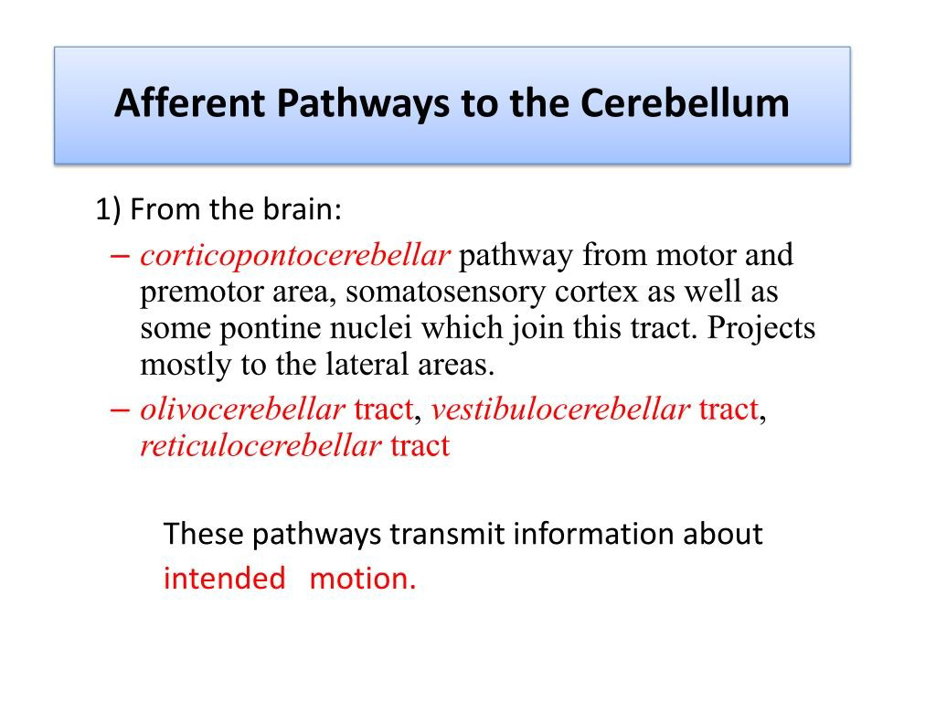

Slide 15
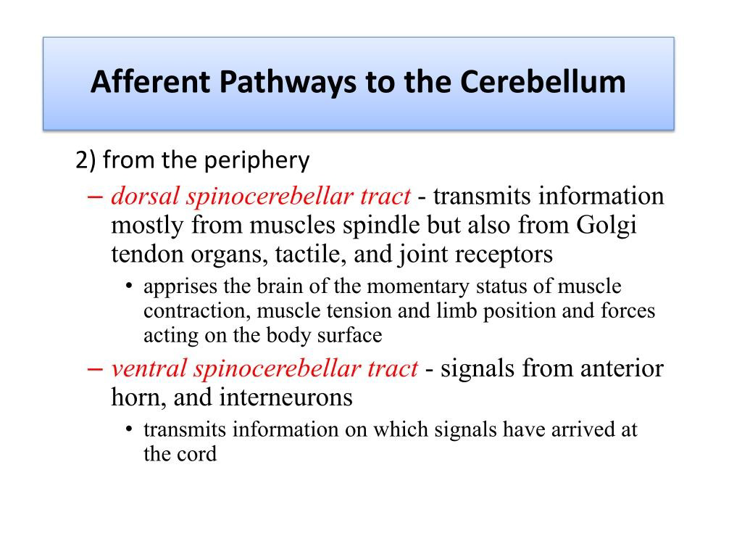

Slide 16
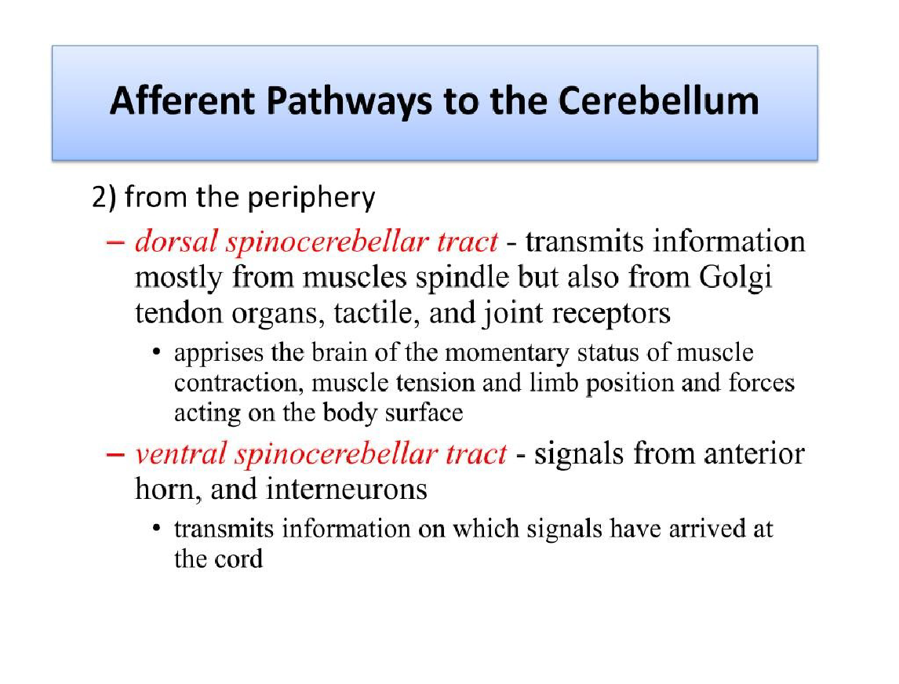

Slide 17
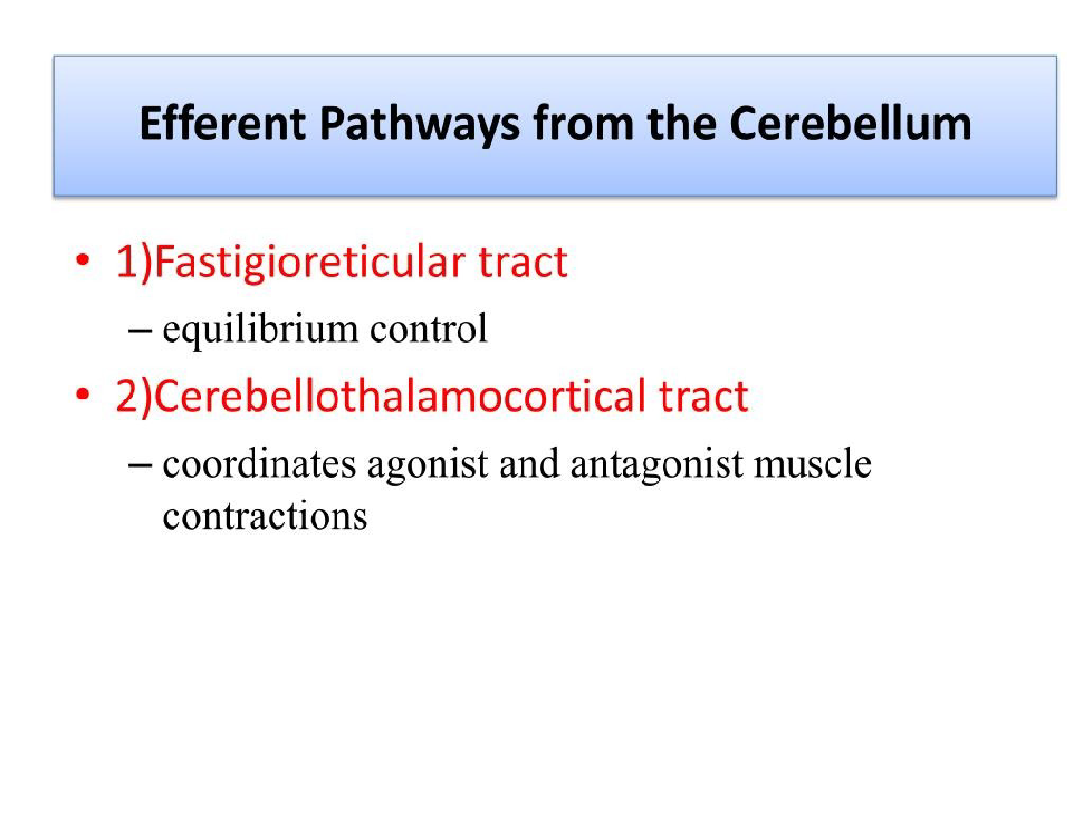

Slide 18
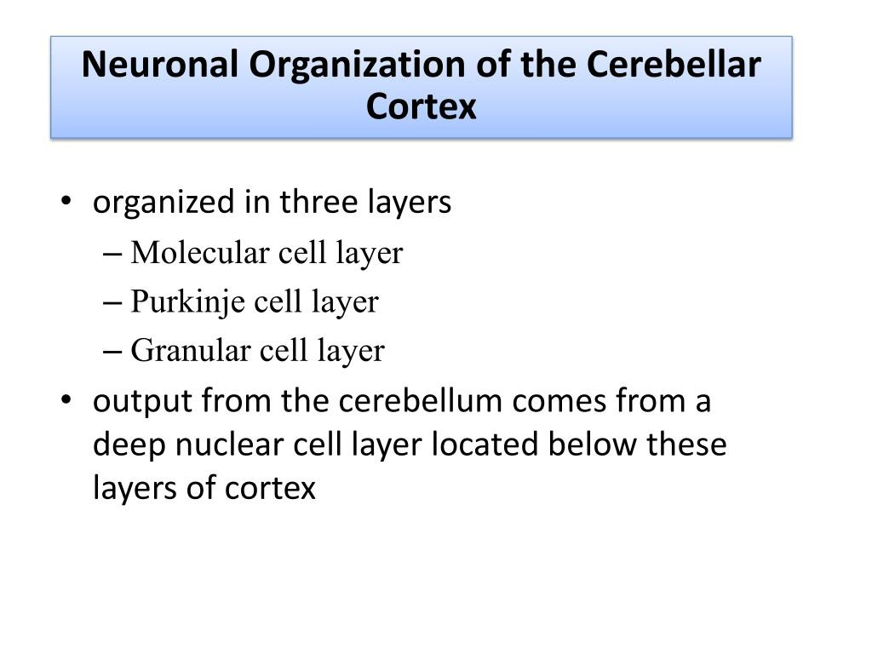

Slide 19
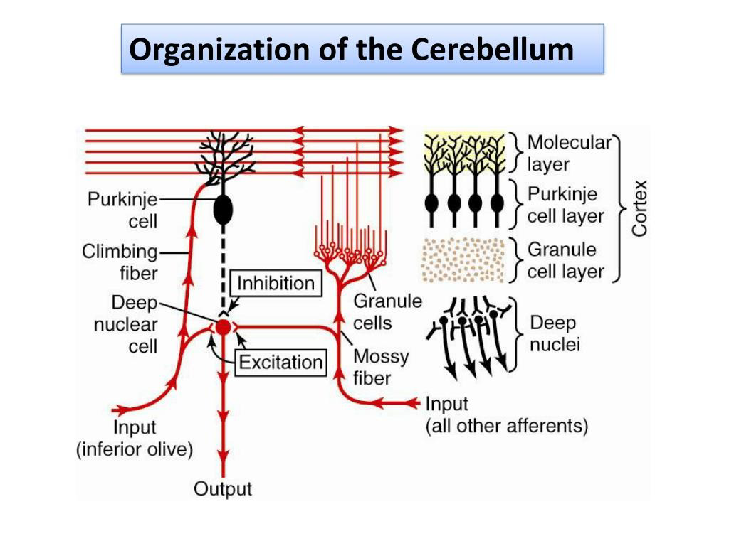

Slide 20
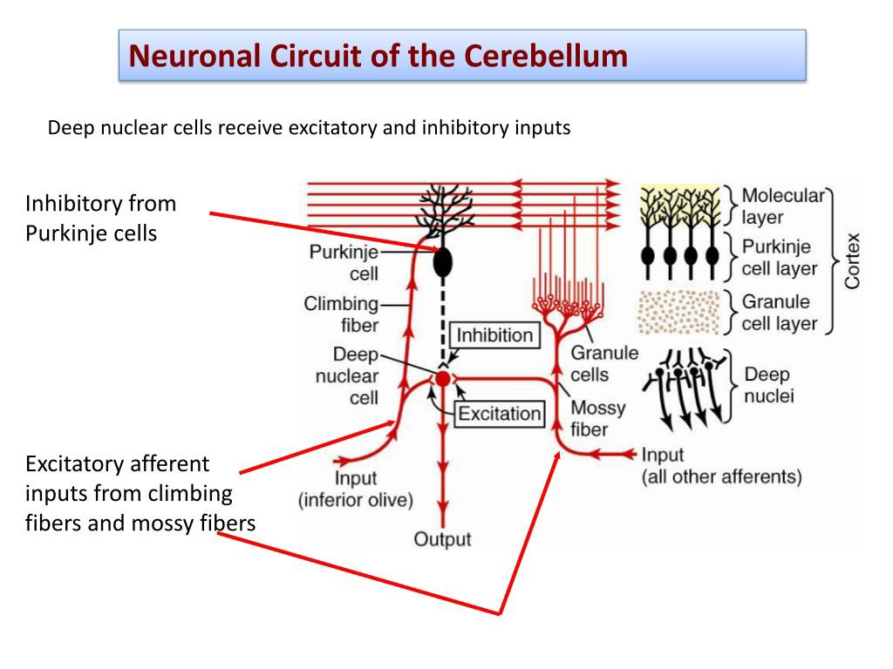

Slide 21
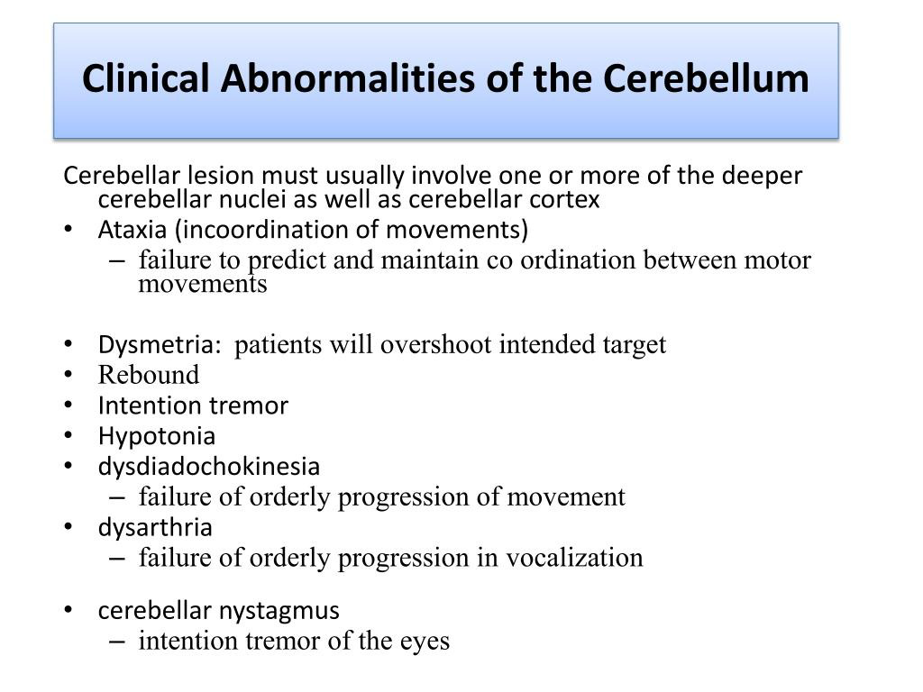

Slide 22
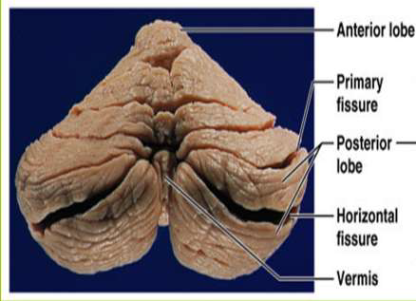
External features
Two cerebellar hemispheres .
Median vermis.
Two surfaces -superior and
inferior
3 fissures:
• fissura prima,
• horizontal fissure and
• posterolateral fissure
3 lobes in each hemisphere
• anterior ,
• posterior and
• flocculonodular.

Slide 23
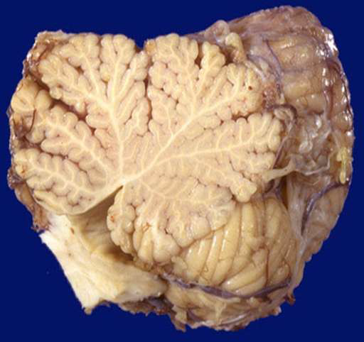
Internal structure
Outer gray matter called cerebralcortex, extensivly folded forming folia
Inner white matter, showing distinctive treelike pattern called Arbor vitae (tree of life)
4 pairs of nuclei within white matter ,the deep
cerebral nuclei

Slide 24
Functions of the cerebellum
Maintenance of equilibrium
Balance, posture, and eye movement.
Coordination of the half-automatic movement
(walking & posture maintenance.)
involuntary but conscious movement (like swinging hand while walking)
Adjustment of muscle tone.
Motor Learning – Motor Skills.
E.g. drawing, writing, playing piano

Slide 25
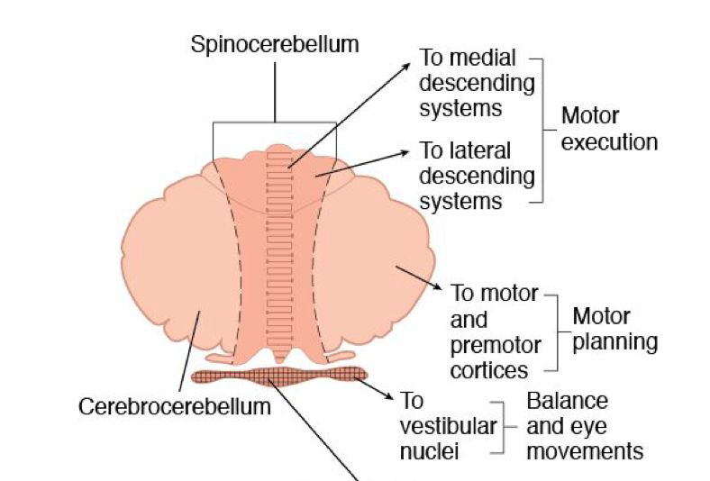
Functional Divisions of Cerebellum

Slide 26
Functional Subdivisions of the Cerebellum
The anatomical subdivisions described above correspond to three major functional subdivisions of the cerebellum.
Vestibulocerebellum:The vestibulocerebellum comprises the flocculonodular lobe and its connections with the lateralvestibular nuclei.
Phylogenetically, the vestibulocerebellum is the oldest part of the cerebellum. As its name implies, it is involvedin vestibular reflexes (such as the vestibuloocular reflex; see below) and in postural maintenance.

Slide 27
Spinocerebellum:The spinocerebellum comprises the vermis and the intermediate zones of the cerebellar cortex, as well asthe fastigial and interposed nuclei. As its name implies, it receives major inputs from the spinocerebellar tract. Its outputprojects to rubrospinal, vestibulospinal, and reticulospinal tracts. It is involved in the integration of sensory input with motorcommands to produce adaptive motor coordination.
Cerebrocerebellum. The cerebrocerebellum is the largest functional subdivision of the human cerebellum, comprising the lateralhemispheres and the dentate nuclei. Its name derives from its extensive connections with the cerebral cortex, via the pontinenuclei (afferents) and the VL thalamus (efferents). It is involved in the planning and timing of movements. In addition, thecerebrocerebellum is involved in the cognitive functions of the cerebellum.

Slide 28
CLINICAL ANATOMY
Dysfunction: damage produces the following:
Ataxia- a disturbance that alters the direction and
extent of voluntary movements; abnormal gait and
uncoordinated movements
Dysmetria- altered range of motion (misjudge distance)
Intention Tremor-oscillating motion, especially of head,
during movement
Vestibular signs-nystagmus, held tilt

